Slide 1
Mini Project Presentation
HOSPITAL E-CARE
Project guide:- Submitted by:
Ms. Bency Wilson Aadith Sanal
Assistant Professor Abrar Farhan. N
Dept. of IT Aeron John Thomas
RSET Biya Mary Ignatias
Group 9-S6 AD

Slide 2
Introduction
Hospital E-Care is a website that aims to provide users with an easy and efficient platform for appointment bookings.
It focuses on the digitalization and utilization of software in the hospital domain.
By developing Hospital E-Care, users can experience a streamlined process for appointment bookings, gain access to information about doctors' availability, and easily provide feedback.

Slide 3
Problem statement (Objective)
Inefficient appointment booking methods and crowding at hospitals are a usual thing which eats up time and is a stress especially to the patients.Also the patients do not have a proper channel to know the doctors who are on leave, hence making it difficult to schedule their appointments accordingly.

Slide 4
Relevance
Efficient Appointment Scheduling: It eliminates manual scheduling, through calls or by physical presence.
Improved Patient Satisfaction: With accurate and up-to-date information on doctor availability, patients can easily book appointments at their preferred times.
Effective Time Management: It helps in reducing crowding and patient waiting time.
Improved Communication and Coordination: Automated notifications and reminders ensure effective communication between the hospital and the patients.
Feedbacks:User experiences help in improving the services of a hospital.

Slide 5
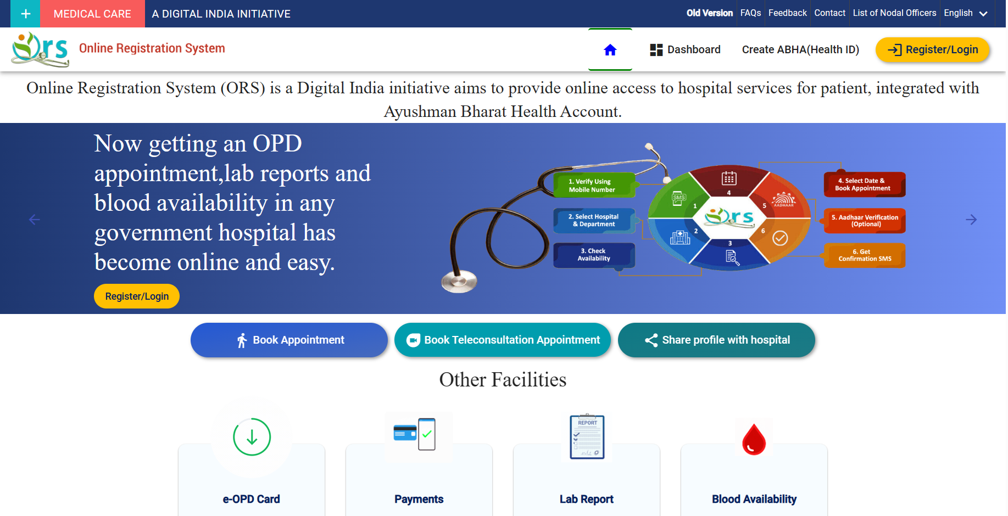
Existing/Related Works
ORS(Online Registration System): It is a digital India initiative which allows users to make hospital appointment online.

Slide 6
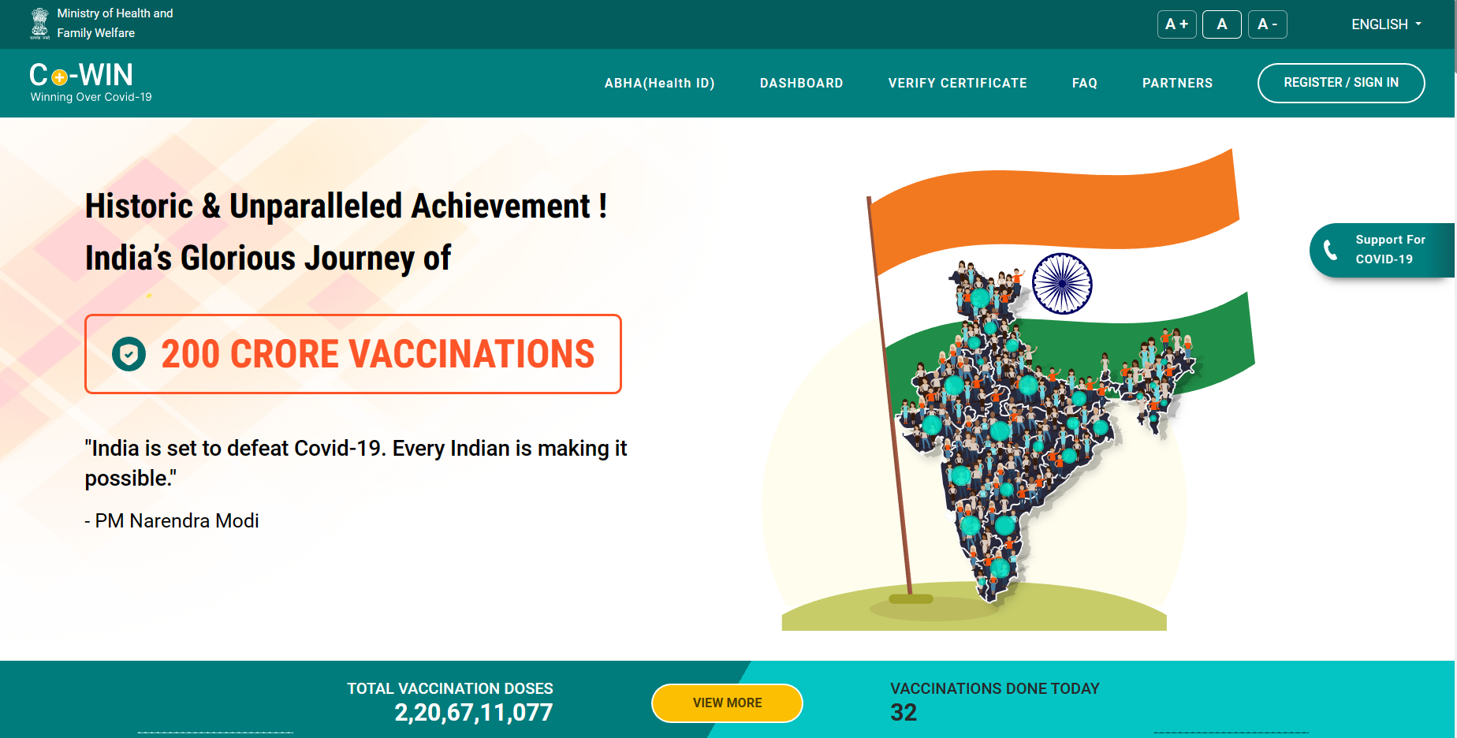
Cowin: It is the online booking system which was introduced during the covid time, for all the people to get vaccinated in a timely manner.It helped in proper social distancing by giving time slots for each patient.

Slide 7

Block diagram
Technical staff
Patients
Login
(Patient)
(Technical Staff)
Add or delete doctor details
Update the leave list and time slots.
Book appointments
View the doctors availability list
Provide feedbacks

Slide 8
Modules name with description in a line
User registration:Allows to create an account, and authenticate themselves to access the appointment booking system.
Appointment Booking Module: This module enables users to schedule appointments with doctors or healthcare providers.
Doctor and Provider Management Module: This module allows hospital administrators to manage doctors and healthcare providers within the system.
Availability and Schedule Management Module: This module handles the availability and schedule management for doctors and healthcare providers.
Notification and Reminder Module: This module sends notifications and reminders to users regarding their upcoming appointments, changes in schedule, or any other relevant information.

Slide 9
DFD
Level 0
Technical Staff
Hospital E Care
Patient

Slide 10
1.1
View, add or update Doctor details
doc
View,add or update time slots
availability
Technical Staff
Change password
user
Edit profile
user

Slide 11
Book Appointment
bookings
1.2
View Doctor details
doc
Patient
Provide feedback
feedback
Change password or profile details
user

Slide 12
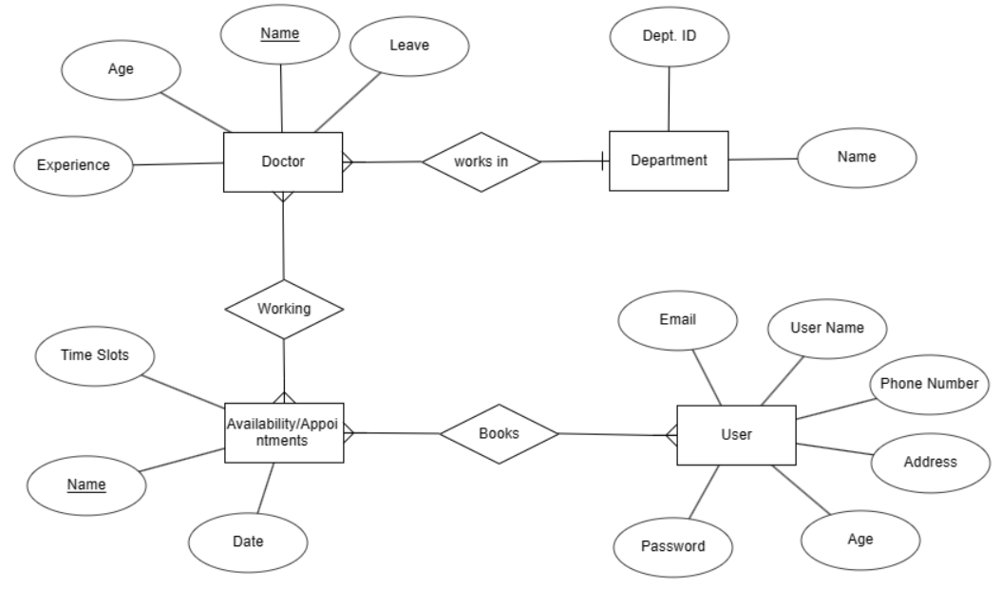
ER Diagram

Slide 13
Implementation details like platforms, IDE, database etc
Database:
SQLite-For creating and maintaining the database.
PHP-To Establish the server connection
Platform: VS Code-Platform for coding and developing the website using html,css and Javascript

Slide 14
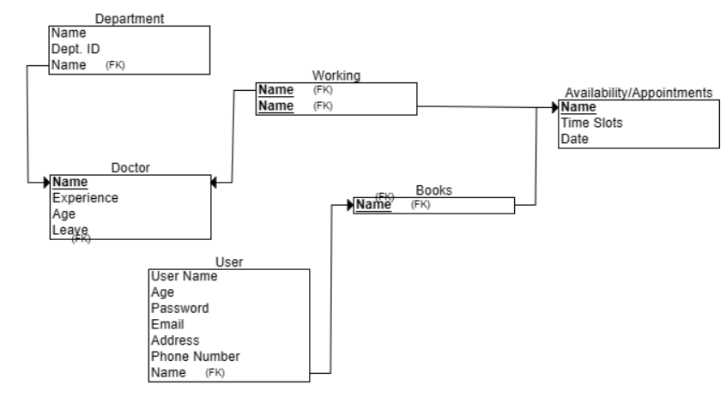
Database design

Slide 15
Sample format/screenshot of work done so far

Slide 16
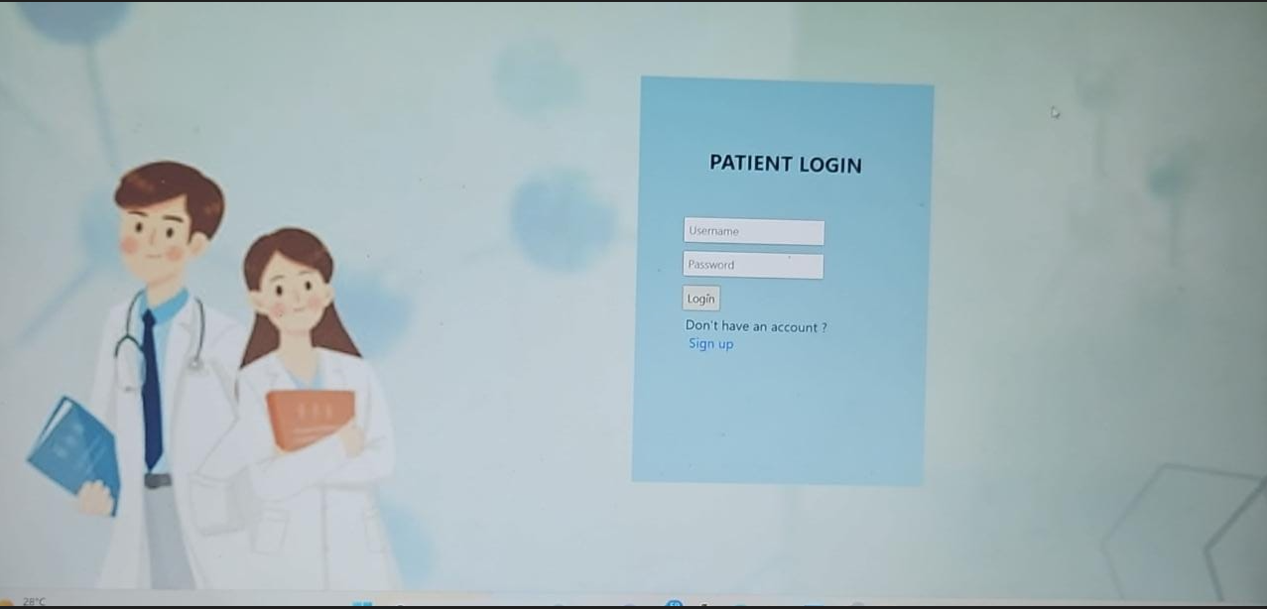

Slide 17
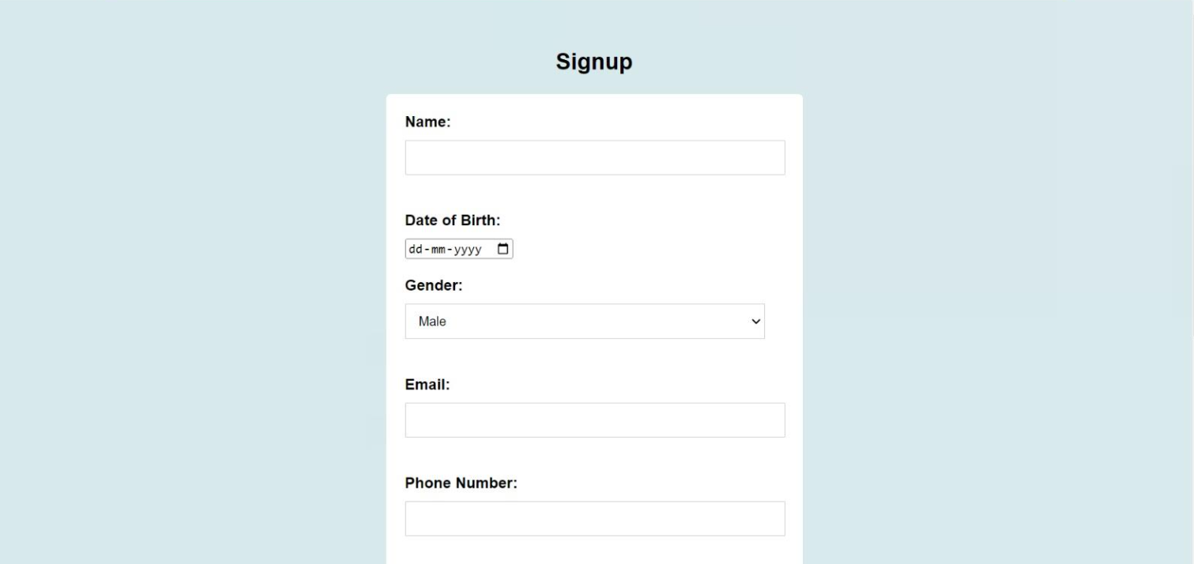

Slide 18
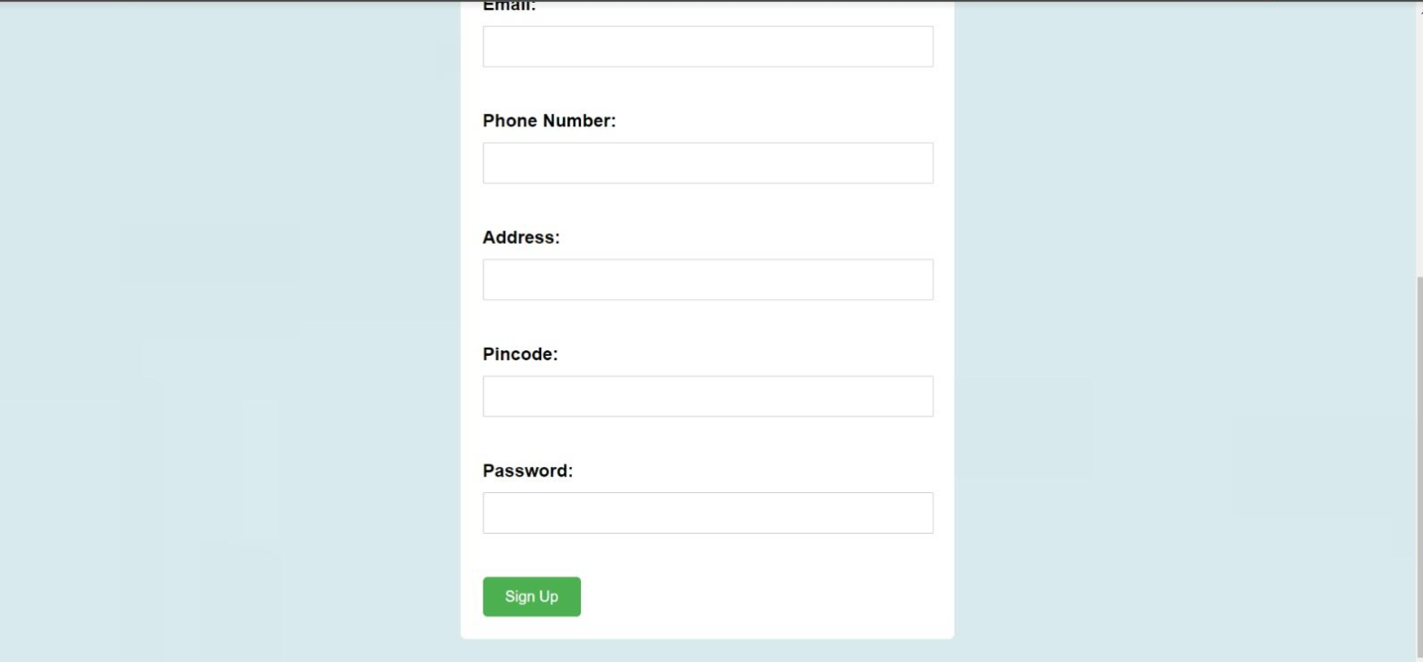

Slide 19
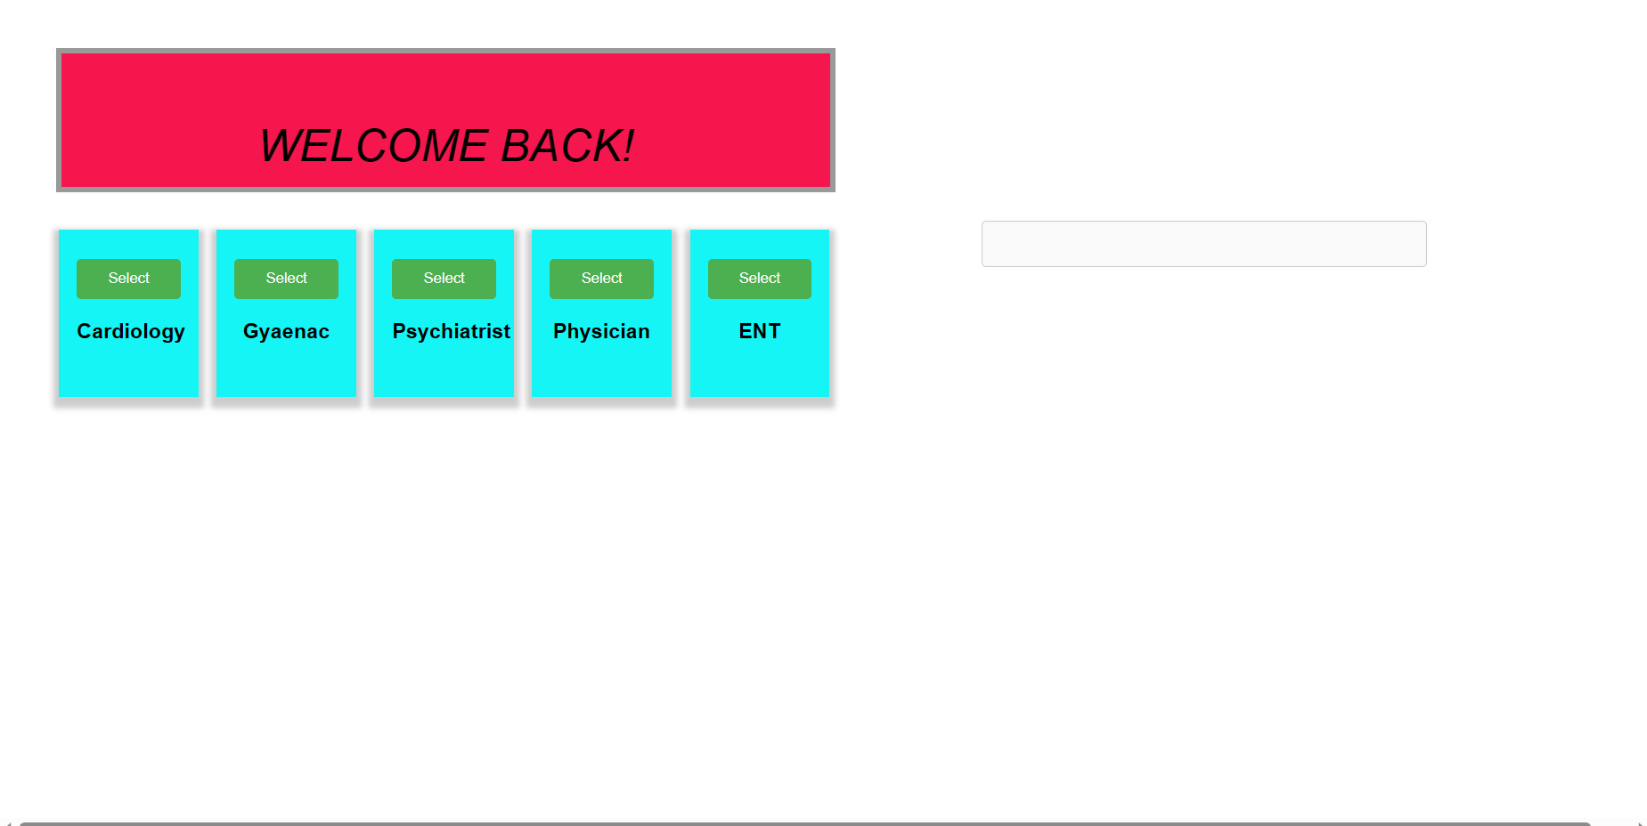

Slide 20
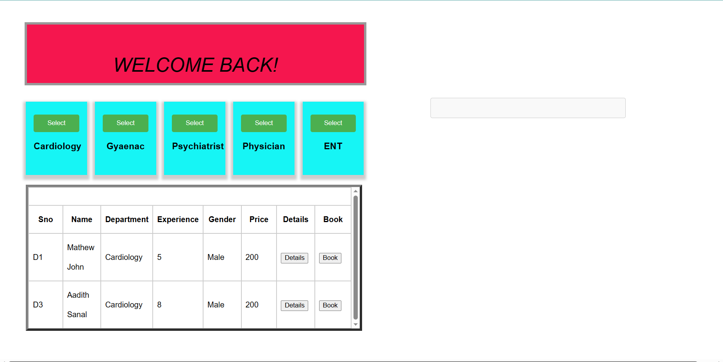

Slide 21
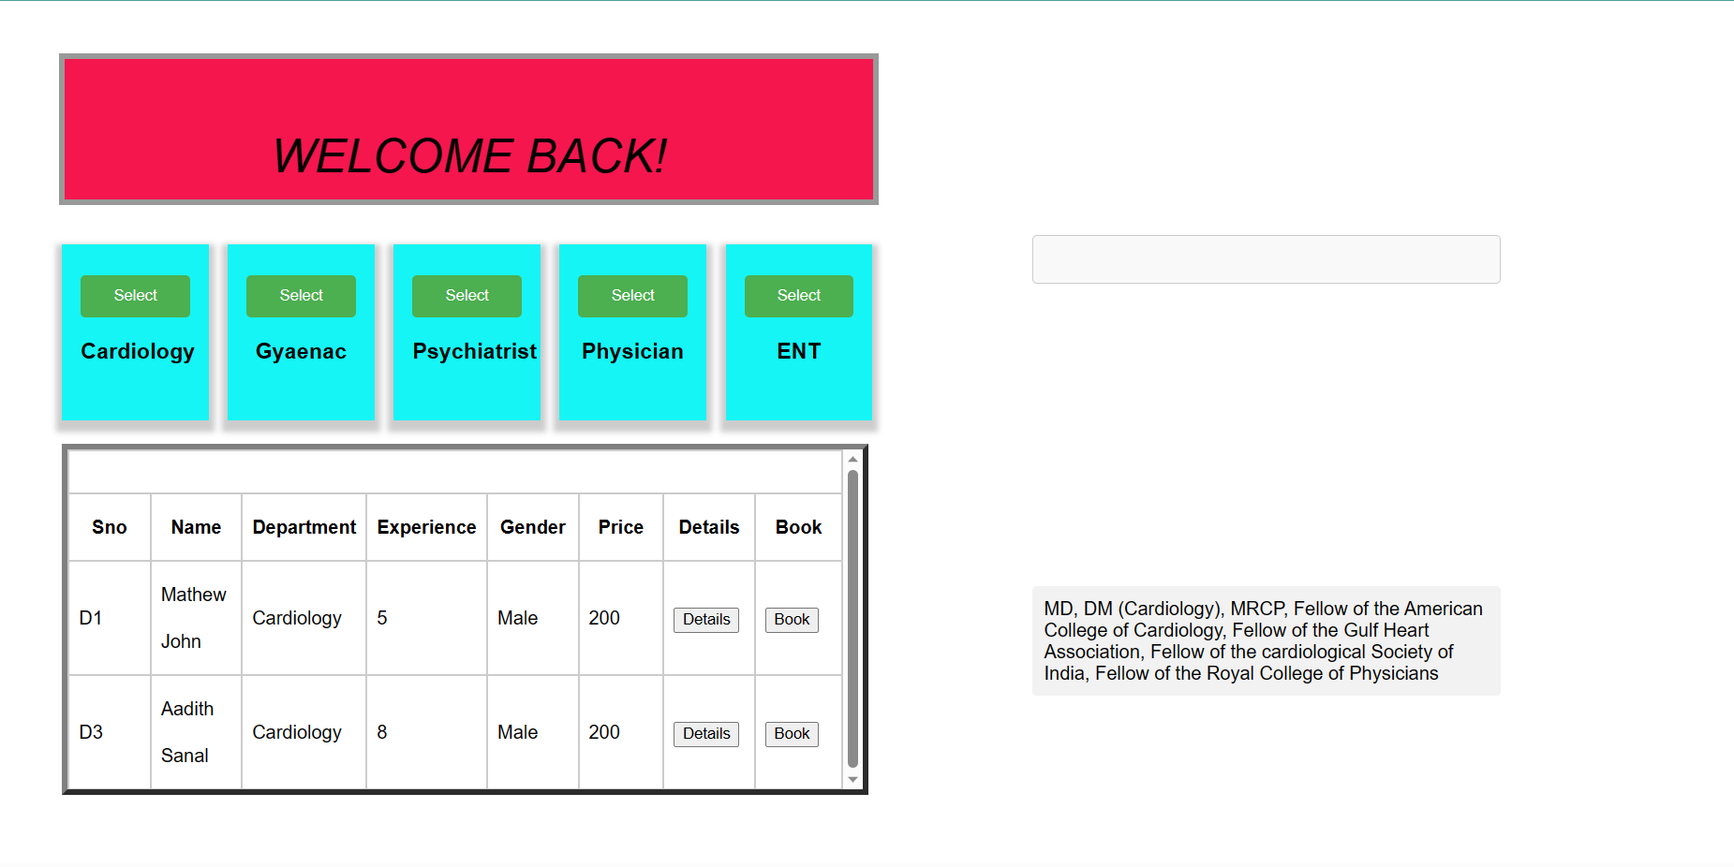

Slide 22
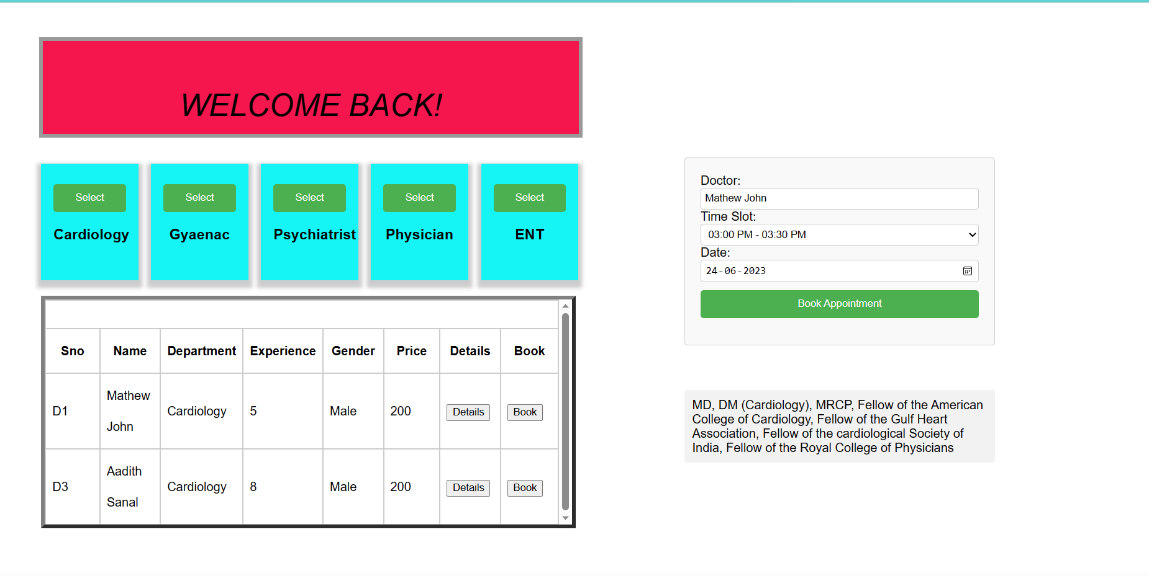

Slide 23
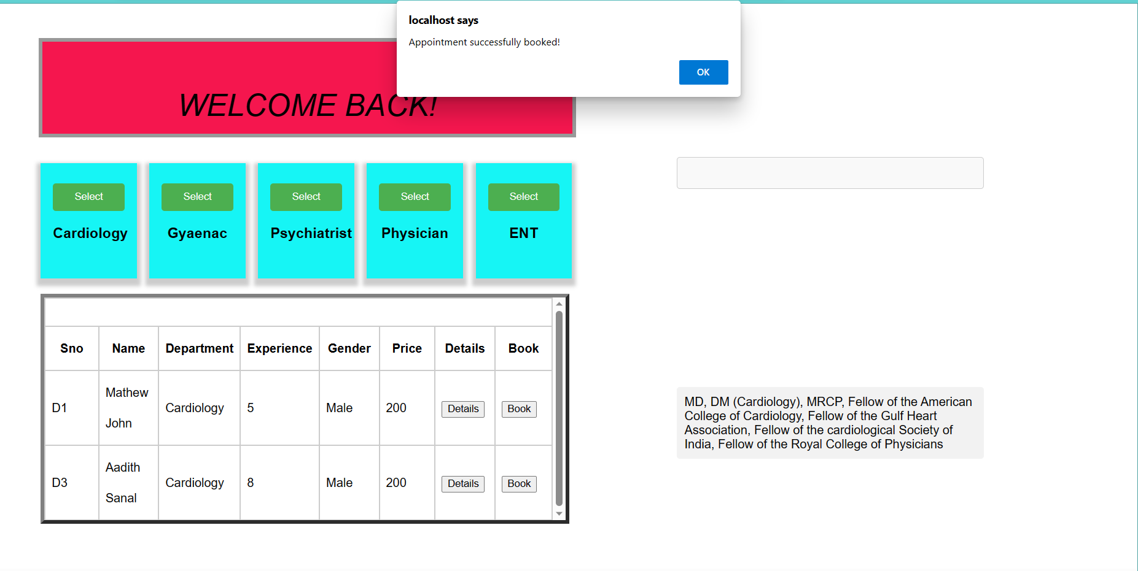

Slide 24
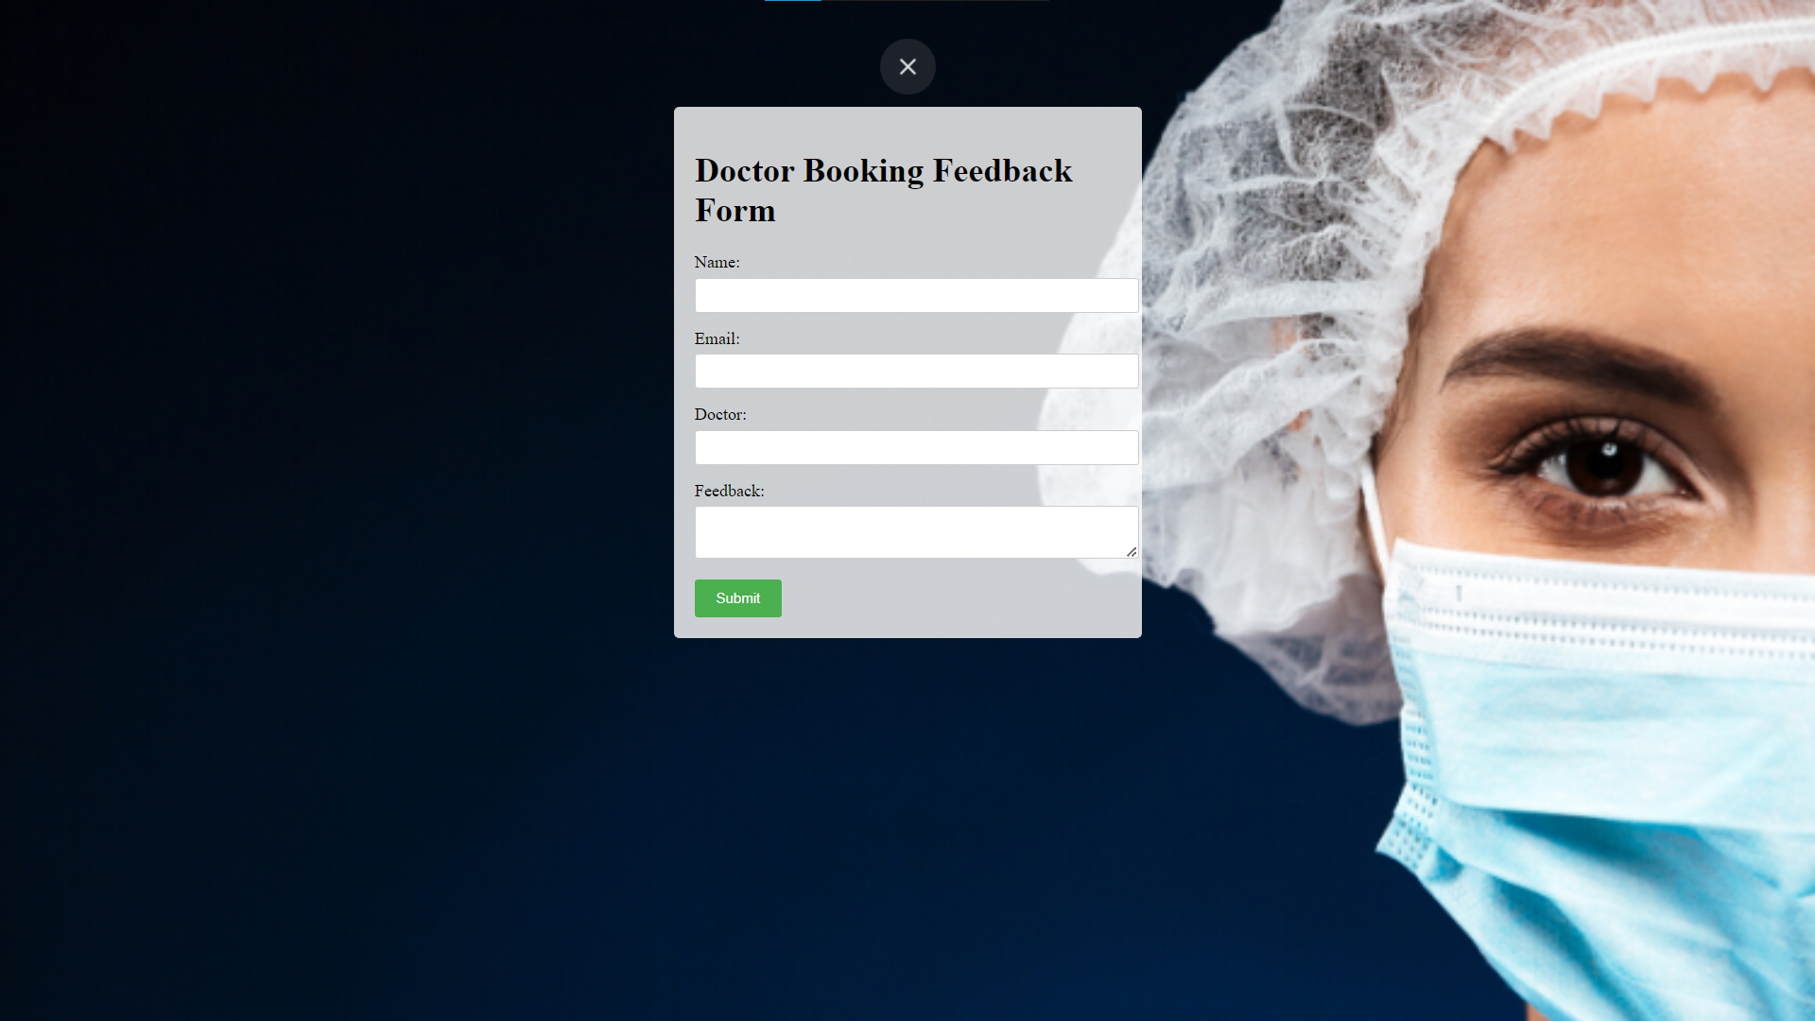

Slide 25
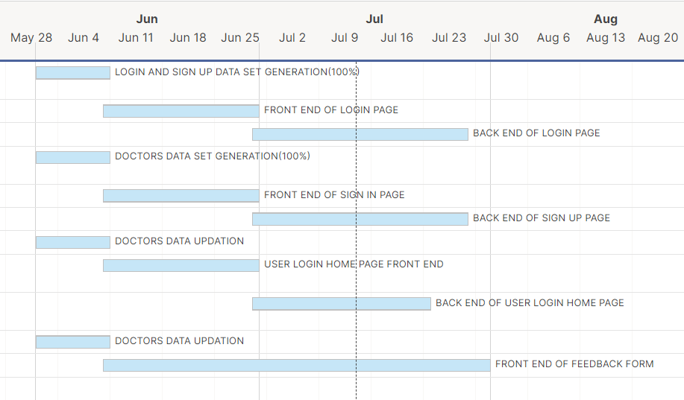
Project Schedule with a Gantt chart and main responsibilities of each member (Task assignment)

Slide 26
Thank You

